Slide 1


Theory of Algebraic Structure in Proof Assistant Systems
Akshobhya Katte Madhusudana
Supervisor: Dr. Jacques Carette
Department of Computing and Software
McMaster University

Slide 2
Contents
Introduction
Definitions
Algebraic structure in proof systems - Survey
Theory of Quasigroup and Loop
Theory of Semigroup and Ring
Theory of Kleene Algebra
Problem in programming algebra
Conclusion
1/23

Slide 3

Introduction
Definition
Survey
Quasigroup and Loop
Semigroup and Ring
Kleene Algebra
Programming algebra
Conclusion
Introduction
Contents
By the early 19th century, mathematicians had discovered how to solve polynomial equation of up-to degree 4. Galois used group to determine the solvability of polynomial equations.
Algebraic structure consists of a set A, a collection of operations on A, and a finite set of axioms, that these operations must satisfy.
Theory of Algebraic Structure in Proof Assistant Systems
2/23

Slide 4
Introduction
Definition
Survey
Quasigroup and Loop
Semigroup and Ring
Kleene Algebra
Programming algebra
Conclusion
Introduction
Contents
Proof assistant system: Proof assistants are software tool to assist with the development of formal proofs by human-machine collaboration
Why proof?
A proof convinces the reader that the statement is correct.
A proof explains why the statement is correct.
We contribute to the Agda standard library, a proof assistant system, so it can be
extended to other relevant fields of algebra.
Agda standard library includes many useful definitions and theorems about basic data structures, such as natural numbers, lists, and vectors.
Theory of Algebraic Structure in Proof Assistant Systems
3/23

Slide 5
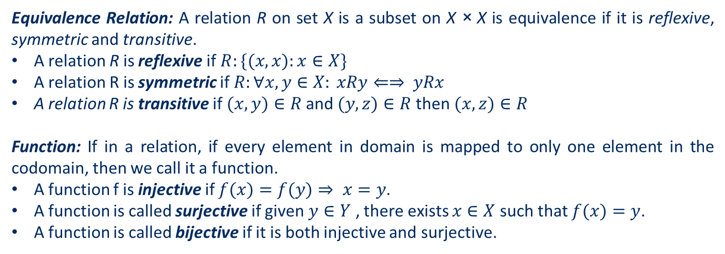
Introduction
Definition
Survey
Quasigroup and Loop
Semigroup and Ring
Kleene Algebra
Programming algebra
Conclusion
Definition
Contents
Equivalence Relation: A relation R on set X is a subset on X × X is equivalence if it is reflexive, symmetric and transitive.
A relation R is reflexive if $R:\{(x,x):x∈X\}$
A relation R is symmetric if $R:∀x,y∈X: xRy⇐⇒ yRx$
A relation R is transitive if $(x,y)∈R$and $(y,z)∈R$then $(x,z)∈R$
Function: If in a relation, if every element in domain is mapped to only one element in the codomain, then we call it a function.
A function f is injective if $f(x)=f(y)⇒ x=y$.
A function is called surjective if given $y∈Y$ , there exists $x∈X$ such that $f(x)=y$.
A function is called bijective if it is both injective and surjective.
Theory of Algebraic Structure in Proof Assistant Systems
4/23

Slide 6
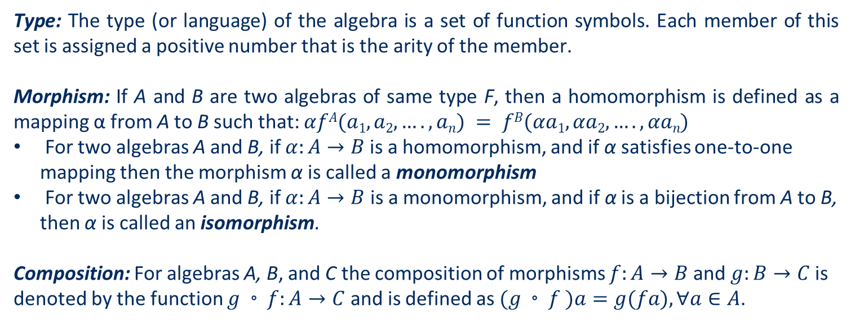
Introduction
Definition
Survey
Quasigroup and Loop
Semigroup and Ring
Kleene Algebra
Programming algebra
Conclusion
Definition
Contents
Type: The type (or language) of the algebra is a set of function symbols. Each member of this set is assigned a positive number that is the arity of the member.
Morphism: If A and B are two algebras of same type F, then a homomorphism is defined as a mapping α from A to B such that: $αfA(a1,a2,….,an) = fB(αa1,αa2,….,αan)$
For two algebras A and B, if $α:A→B$is a homomorphism, and if α satisfies one-to-one mapping then the morphism α is called a monomorphism
For two algebras A and B, if $α:A→B$ is a monomorphism, and if α is a bijection from A to B, then α is called an isomorphism.
Composition: For algebras A, B, and C the composition of morphisms $f:A→B$ and $g:B→C$is denoted by the function $g◦f:A→C$ and is defined as $(g◦f )a=g(fa),∀a∈A$.
Theory of Algebraic Structure in Proof Assistant Systems
5/23

Slide 7
Introduction
Definition
Survey
Quasigroup and Loop
Semigroup and Ring
Kleene Algebra
Programming algebra
Conclusion
Algebraic Structures in Proof Systems - Survey
Contents
Proof Systems:
Agda 2:Agda standard library
Coq: Mathematical components
Idris 2 – library code
Lean 3 – Mathlib
Experiment:
Create a web crawler to skim the source code.
Create a clickable table that takes to definition of the structures in the source code.
Theory of Algebraic Structure in Proof Assistant Systems
6/23

Slide 8
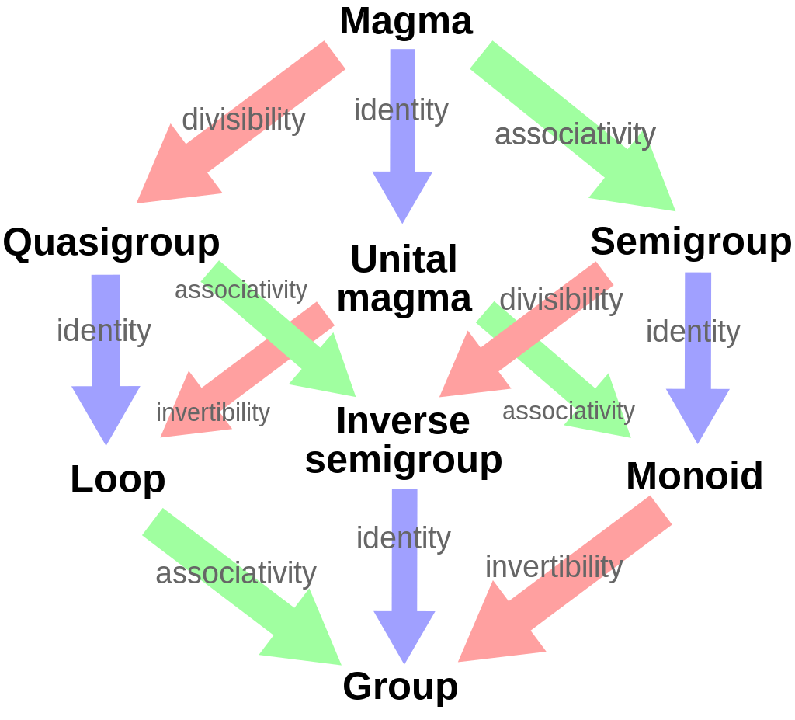
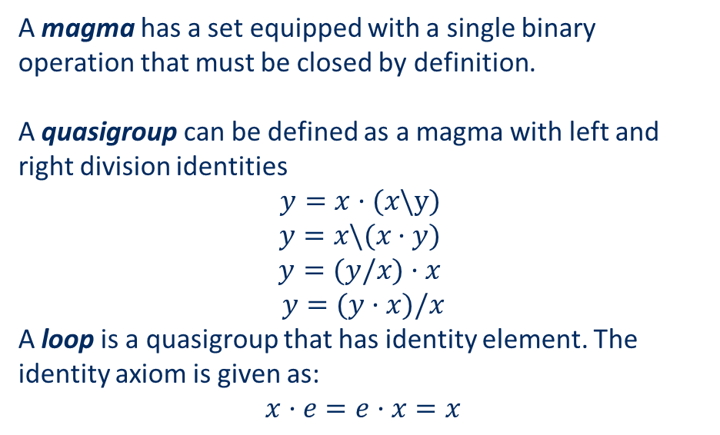
Introduction
Definition
Survey
Quasigroup and Loop
Semigroup and Ring
Kleene Algebra
Programming algebra
Conclusion
Theory of Quasigroup and Loop
Contents
A magma has a set equipped with a single binary operation that must be closed by definition.
A quasigroup can be defined as a magma with left and right division identities
$$y=x·(x\backslash y)$$
$$y=x\backslash (x·y)$$
$$y=(y/x)·x$$
$$y=(y·x)/x$$
A loop is a quasigroup that has identity element. The identity axiom is given as:
$$x·e=e·x=x$$
Theory of Algebraic Structure in Proof Assistant Systems
7/23

Slide 9
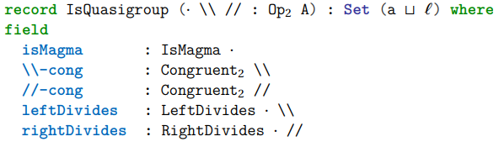
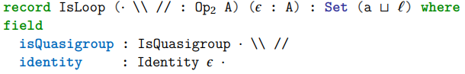
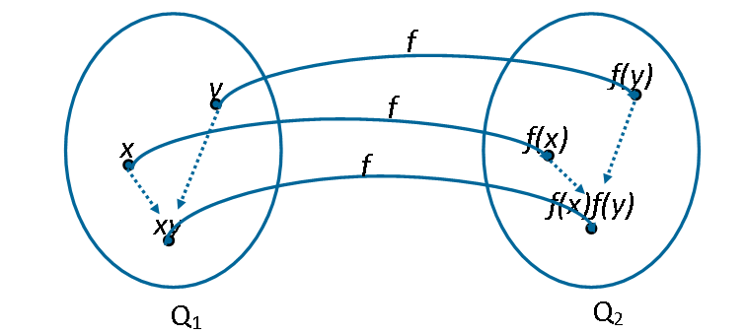
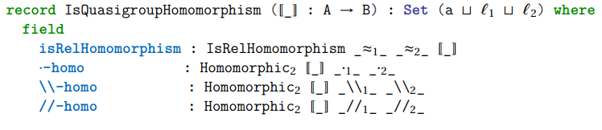
Introduction
Definition
Survey
Quasigroup and Loop
Semigroup and Ring
Kleene Algebra
Programming algebra
Conclusion
Theory of Quasigroup and Loop
Contents
Homomorphism of quasigroup
Theory of Algebraic Structure in Proof Assistant Systems
8/23

Slide 10
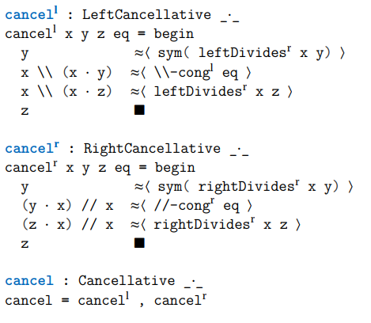
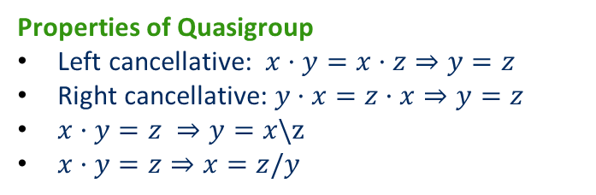
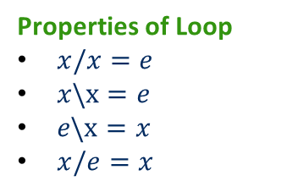
Introduction
Definition
Survey
Quasigroup and Loop
Semigroup and Ring
Kleene Algebra
Programming algebra
Conclusion
Theory of Quasigroup and Loop
Contents
Properties of Quasigroup
Left cancellative: $x·y=x·z⇒y=z$
Right cancellative: $y·x=z·x⇒y=z$
$x·y=z ⇒y=x\backslash z$
$x·y=z⇒x=z/y$
Properties of Loop
$x/x=e$
$x\backslash x=e$
$e\backslash x=x$
$x/e=x$
Theory of Algebraic Structure in Proof Assistant Systems
9/23

Slide 11

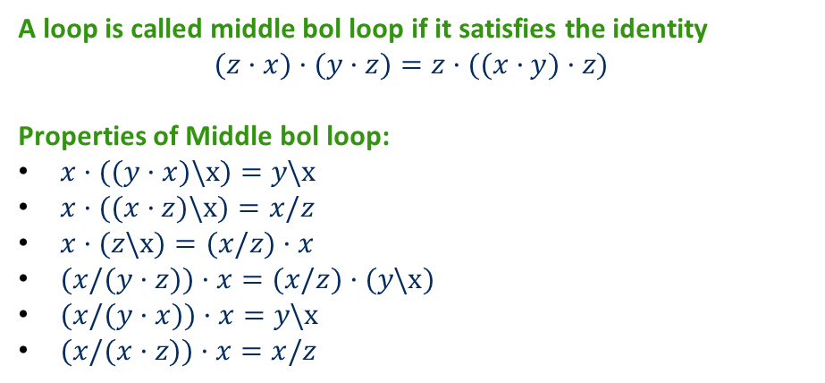
Introduction
Definition
Survey
Quasigroup and Loop
Semigroup and Ring
Kleene Algebra
Programming algebra
Conclusion
Theory of Quasigroup and Loop
Contents
A loop is called middle bol loop if it satisfies the identity
$$(z·x)·(y·z)=z·((x·y)·z)$$
Properties of Middle bol loop:
$x·((y·x)\backslash x)=y\backslash x$
$x·((x·z)\backslash x)=x/z$
$x·(z\backslash x)=(x/z)·x$
$(x/(y·z))·x=(x/z)·(y\backslash x)$
$(x/(y·x))·x=y\backslash x$
$(x/(x·z))·x=x/z$
Theory of Algebraic Structure in Proof Assistant Systems
10/23

Slide 12
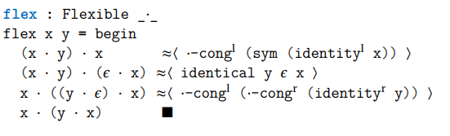
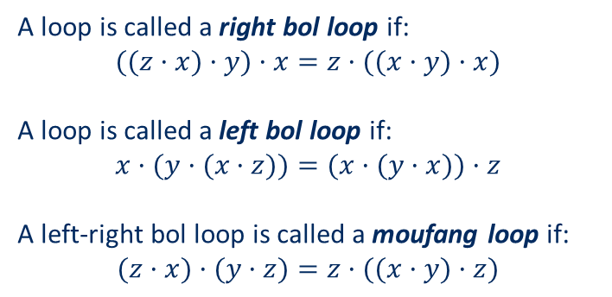
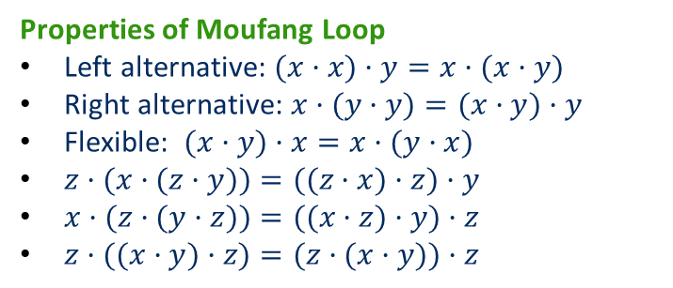
Introduction
Definition
Survey
Quasigroup and Loop
Semigroup and Ring
Kleene Algebra
Programming algebra
Conclusion
Theory of Quasigroup and Loop
Contents
A loop is called a right bol loop if:
$$((z·x)·y)·x=z·((x·y)·x)$$
A loop is called a left bol loop if:
$$x·(y·(x·z))=(x·(y·x))·z$$
A left-right bol loop is called a moufang loop if:
$$(z·x)·(y·z)=z·((x·y)·z)$$
Properties of Moufang Loop
Left alternative: $(x·x)·y=x·(x·y)$
Right alternative: $x·(y·y)=(x·y)·y$
Flexible: $(x·y)·x=x·(y·x)$
$z·(x·(z·y))=((z·x)·z)·y$
$x·(z·(y·z))=((x·z)·y)·z$
$z·((x·y)·z)=(z·(x·y))·z$
Theory of Algebraic Structure in Proof Assistant Systems
11/23

Slide 13
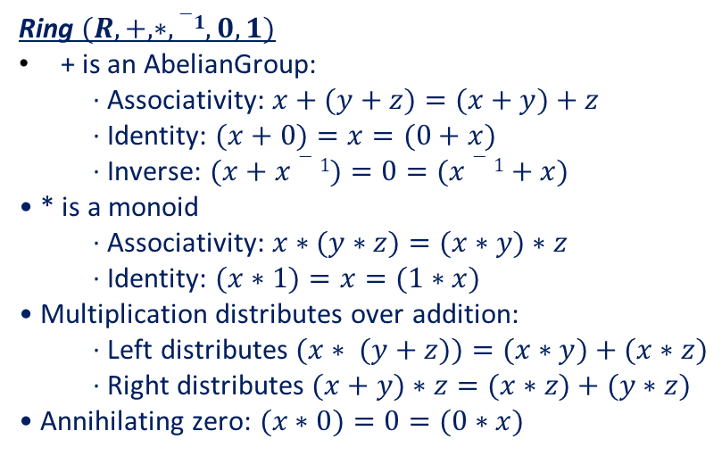
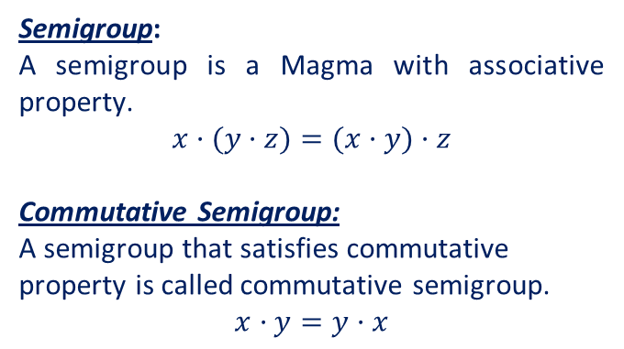
Introduction
Definition
Survey
Quasigroup and Loop
Semigroup and Ring
Kleene Algebra
Programming algebra
Conclusion
Theory of Semigroup and Ring
Contents
Semigroup:
A semigroup is a Magma with associative property.
$$x·(y·z)=(x·y)·z$$
Commutative Semigroup:
A semigroup that satisfies commutative property is called commutative semigroup.
$$x·y=y·x$$
Ring $(R,+,∗,−1, 0,1)$
+ is an AbelianGroup:
· Associativity: $x+(y+z)=(x+y)+z$
· Identity: $(x+0)=x=(0+x)$
· Inverse: $(x+x−1)=0=(x−1+x)$
• * is a monoid
· Associativity: $x∗(y∗z)=(x∗y)∗z$
· Identity: $(x∗1)=x=(1∗x)$
• Multiplication distributes over addition:
· Left distributes $(x∗ (y+z))=(x∗y)+(x∗z)$
· Right distributes $(x+y)∗z=(x∗z)+(y∗z)$
• Annihilating zero: $(x∗0)=0=(0∗x)$
Theory of Algebraic Structure in Proof Assistant Systems
12/23

Slide 14
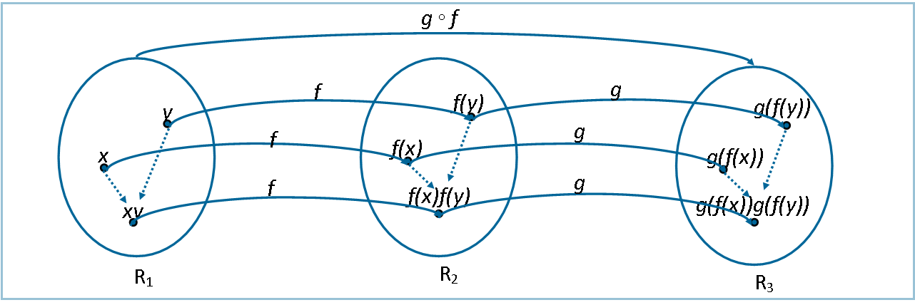
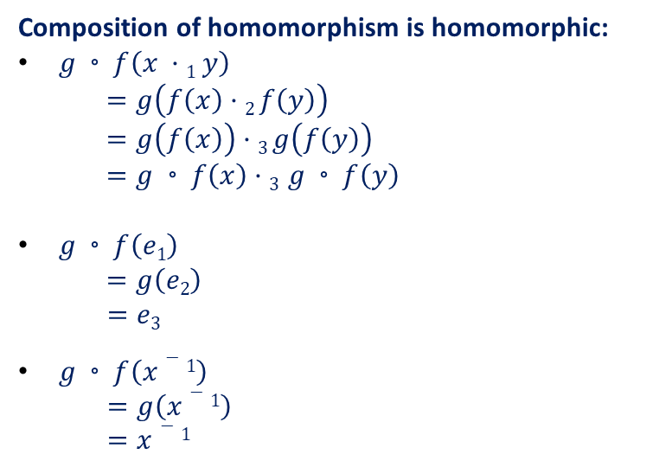
Introduction
Definition
Survey
Quasigroup and Loop
Semigroup and Ring
Kleene Algebra
Programming algebra
Conclusion
Theory of Semigroup and Ring
Contents
Composition of homomorphism is homomorphic:
$g◦f\left(x ·1 y\right)$
$$=g\left(f\left(x\right)·2 f\left(y\right)\right)$$
$$=g\left(f\left(x\right)\right)·3 g\left(f\left(y\right)\right)$$
$$=g◦f\left(x\right)·3 g◦f\left(y\right)$$
$g◦f\left(e1\right)$
$$=g\left(e2\right)$$
$=e3$
$g◦f\left(x−1\right)$
$=g\left(x−1\right)$
$=x−1$
Theory of Algebraic Structure in Proof Assistant Systems
13/23

Slide 15
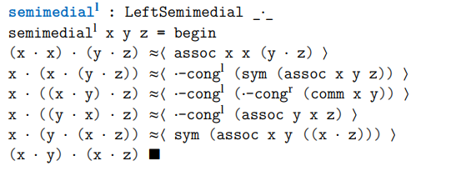
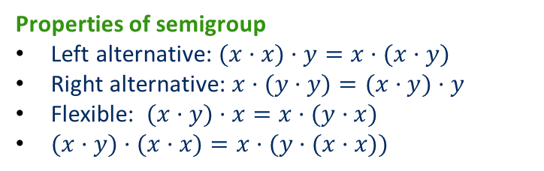
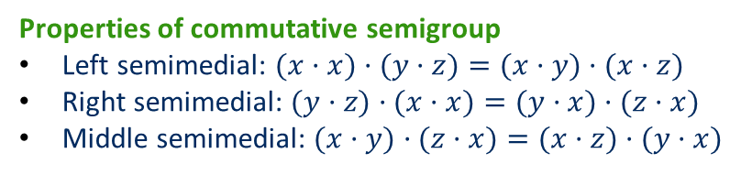
Introduction
Definition
Survey
Quasigroup and Loop
Semigroup and Ring
Kleene Algebra
Programming algebra
Conclusion
Theory of Semigroup and Ring
Contents
Properties of semigroup
Left alternative: $(x·x)·y=x·(x·y)$
Right alternative: $x·(y·y)=(x·y)·y$
Flexible: $(x·y)·x=x·(y·x)$
$(x·y)·(x·x)=x·(y·(x·x))$
Properties of commutative semigroup
Left semimedial: $(x·x)·(y·z)=(x·y)·(x·z)$
Right semimedial: $(y·z)·(x·x)=(y·x)·(z·x)$
Middle semimedial: $(x·y)·(z·x)=(x·z)·(y·x)$
Theory of Algebraic Structure in Proof Assistant Systems
14/23

Slide 16
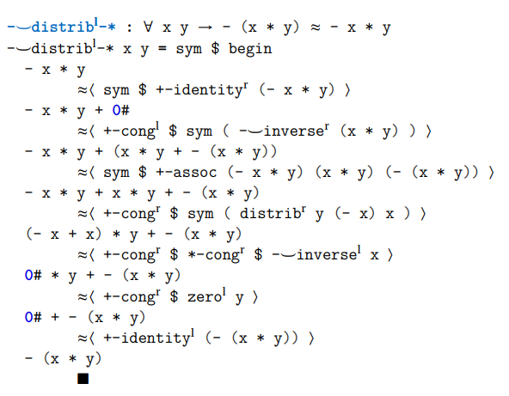
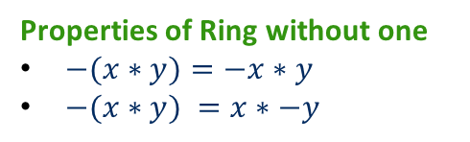
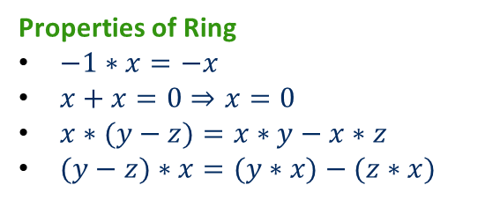
Introduction
Definition
Survey
Quasigroup and Loop
Semigroup and Ring
Kleene Algebra
Programming algebra
Conclusion
Theory of Semigroup and Ring
Contents
Properties of Ring without one
$−(x∗y)=−x∗y$
$−(x∗y) =x∗−y$
Properties of Ring
$−1∗x=−x$
$x+x=0⇒x=0$
$x∗(y−z)=x∗y−x∗z$
$(y−z)∗x=(y∗x)−(z∗x)$
Theory of Algebraic Structure in Proof Assistant Systems
15/23

Slide 17
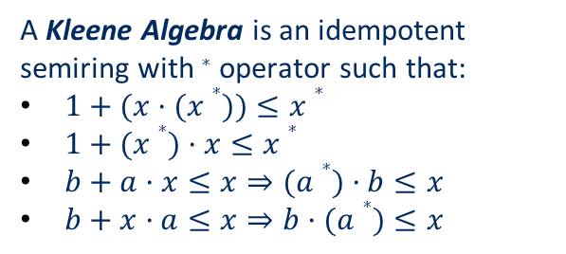
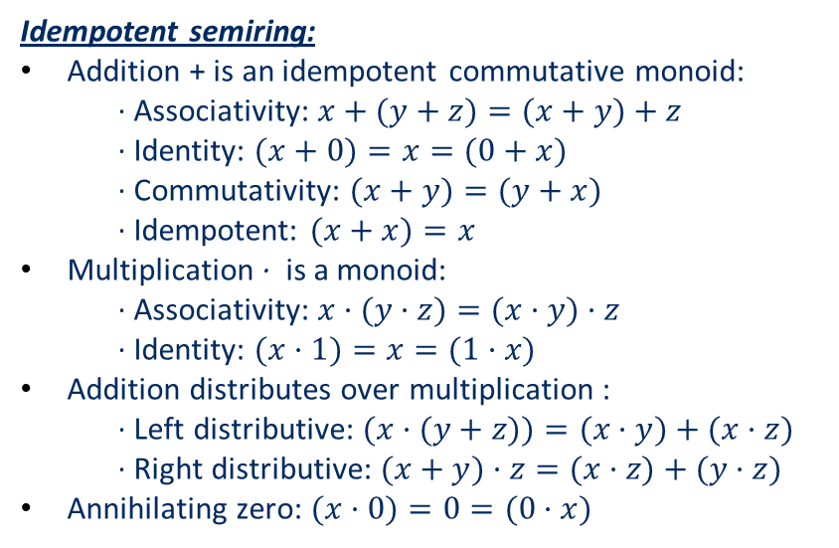
Introduction
Definition
Survey
Quasigroup and Loop
Semigroup and Ring
Kleene Algebra
Programming algebra
Conclusion
Theory of Kleene Algebra
Contents
Idempotent semiring:
Addition + is an idempotent commutative monoid:
· Associativity: $x+(y+z)=(x+y)+z$
· Identity: $(x+0)=x=(0+x)$
· Commutativity: $(x+y)=(y+x)$
· Idempotent: $(x+x)=x$
Multiplication · is a monoid:
· Associativity: $x·(y·z)=(x·y)·z$
· Identity: $(x·1)=x=(1·x)$
Addition distributes over multiplication :
· Left distributive: $(x·(y+z))=(x·y)+(x·z)$
· Right distributive: $(x+y)·z=(x·z)+(y·z)$
Annihilating zero: $(x·0)=0=(0·x)$
A Kleene Algebra is an idempotent semiring with ∗ operator such that:
$1+(x·(x∗))≤x∗$
$1+(x∗)·x≤x∗$
$b+a·x≤x⇒(a∗)·b≤x$
$b+x·a≤x⇒b·(a∗)≤x$
Theory of Algebraic Structure in Proof Assistant Systems
16/23

Slide 18
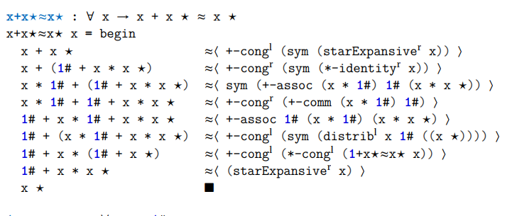
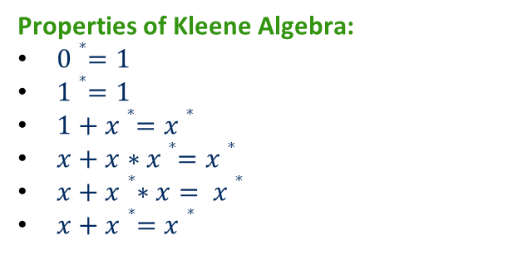
Introduction
Definition
Survey
Quasigroup and Loop
Semigroup and Ring
Kleene Algebra
Programming algebra
Conclusion
Theory of Kleene Algebra
Contents
Properties of Kleene Algebra:
$0∗=1$
$1∗=1$
$1+x∗=x∗$
$x+x∗x∗=x∗$
$x+x∗∗x= x∗$
$x+x∗=x∗$
Theory of Algebraic Structure in Proof Assistant Systems
17/23

Slide 19

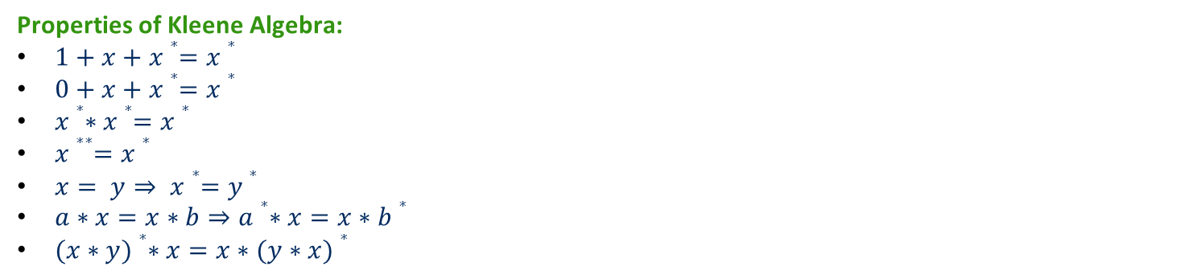
Introduction
Definition
Survey
Quasigroup and Loop
Semigroup and Ring
Kleene Algebra
Programming algebra
Conclusion
Theory of Kleene Algebra
Contents
Properties of Kleene Algebra:
$1+x+x∗=x∗$
$0+x+x∗=x∗$
$x∗∗x∗=x∗$
$x∗∗=x∗$
$x= y⇒ x∗=y∗$
$a∗x=x∗b⇒a∗∗x=x∗b∗$
$(x∗y)∗∗x=x∗(y∗x)∗$
Theory of Algebraic Structure in Proof Assistant Systems
18/23

Slide 20
Introduction
Definition
Survey
Quasigroup and Loop
Semigroup and Ring
Kleene Algebra
Programming algebra
Conclusion
Problem in Programming Algebra
Contents
Analyze 5 problems in programming algebra:
Equivalent but structurally different e.g. Quasigroups
Ambiguity in naming e.g. Ring and Rng, Nearring (*-semigroup/*-monoid).
Redundant field in structural inheritance: e.g. semiring (+-commutativeMonoid and *-monoid).
Identical structures e.g. Nearring
Equivalent structures e.g. Bounded semilattice and Idempotent commutative monoid
Theory of Algebraic Structure in Proof Assistant Systems
19/23

Slide 21
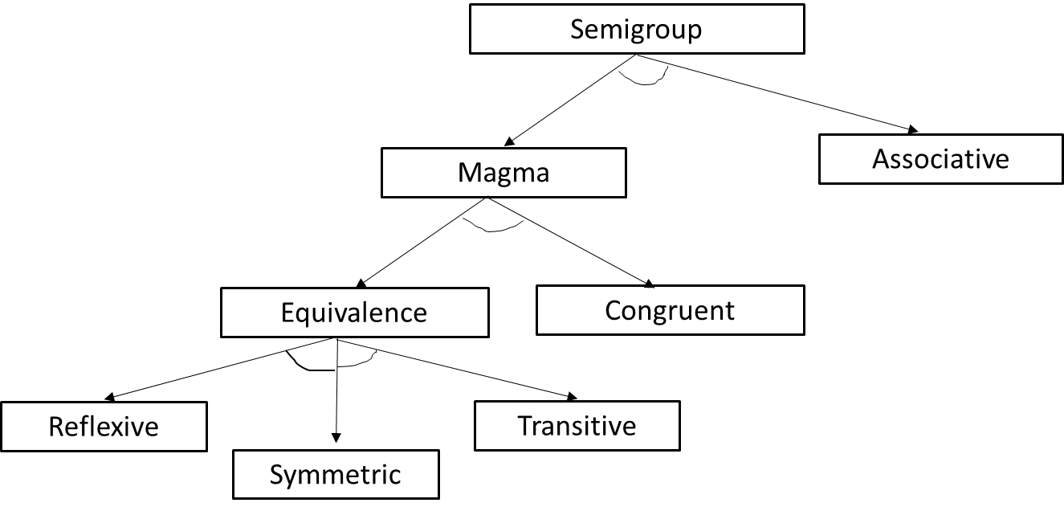
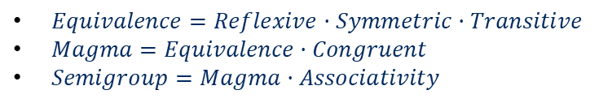
Introduction
Definition
Survey
Quasigroup and Loop
Semigroup and Ring
Kleene Algebra
Programming algebra
Conclusion
Problem in Programming Algebra
Contents
Product Family Algebra:
- AND decomposition (Consists of)
- OR decomposition
$Equivalence=Reflexive·Symmetric·Transitive$
$Magma=Equivalence·Congruent$
$Semigroup=Magma·Associativity$
Theory of Algebraic Structure in Proof Assistant Systems
20/23

Slide 22
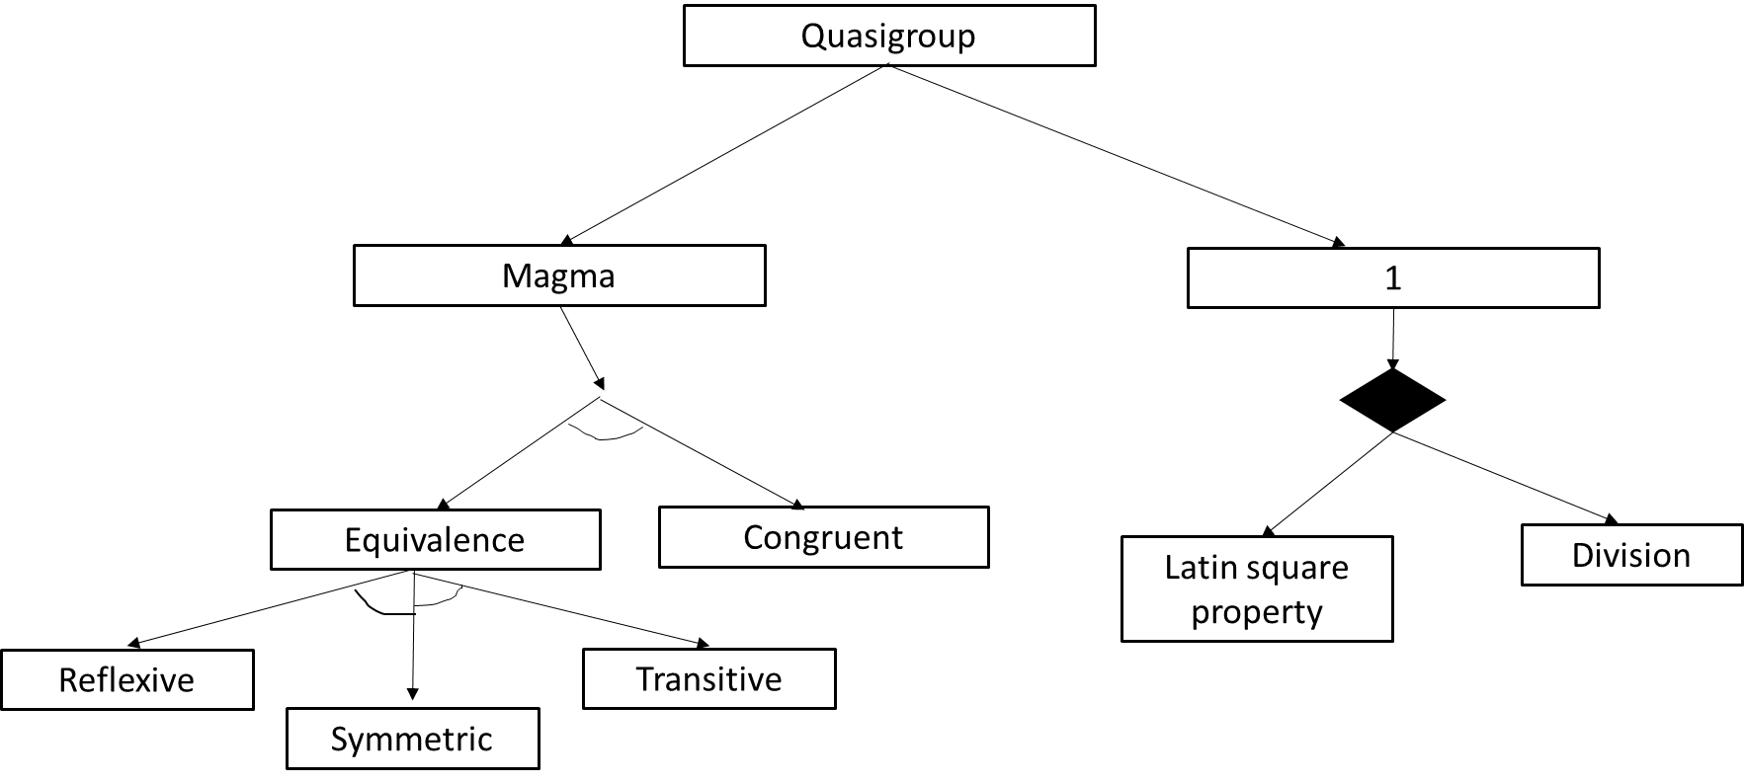
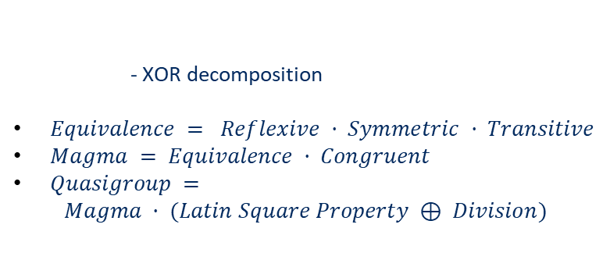
Introduction
Definition
Survey
Quasigroup and Loop
Semigroup and Ring
Kleene Algebra
Programming algebra
Conclusion
Problem in Programming Algebra
Contents
- XOR decomposition
$Equivalence = Reflexive · Symmetric · Transitive$
$Magma = Equivalence · Congruent$
$Quasigroup =$
$$Magma · (Latin Square Property ⊕ Division)$$
Theory of Algebraic Structure in Proof Assistant Systems
21/23

Slide 23
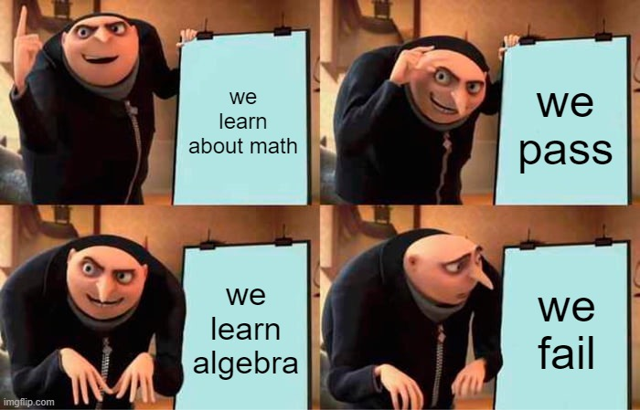
Introduction
Definition
Survey
Quasigroup and Loop
Semigroup and Ring
Kleene Algebra
Programming algebra
Conclusion
Conclusion
Contents
Conclusion
Define the scope by survey
Theory of Algebraic structures in Agda
Analyze problems that arise
Future work
Extend product family algebra
Generated libraries to standard library
More concrete definitions of constructs
Theory of Algebraic Structure in Proof Assistant Systems
22/23

Slide 24

Questions?

